Slide 1
Case Study
Beers & Breweries
Notes:
Speaker: Rajesh
Firstly, Mr. CEO, we would like to thank for giving this opportunity to study your Beers and Breweries business and taking the time from your busy schedule to listen to our presentation.

Slide 2
Scope
Target audience: Budweiser CEO and CFO executives
Brewery and beer summary
Facts about ABV and IBU
Relationship between ABV and IBU
KNN Classification
ABV And Ounces By State
Notes:
Speaker: Rajesh
Notes: The primary focus of this presentation is to address some of the key questions.
How many Breweries are there by state
Median Alcohol by Volume (ABV) and beer bitterness (IBU) by state
Which states has beers with highest level of alcohol by volume and bitterness
We will also present detailed information related to alcohol by volume and will also address the relation between alcohol by volume and bitterness

Slide 3
Beers and Brewery Data
Two sources of data (beers and breweries)
2410 US craft beers
Beer names
Style
Sizes (Ounces)
Alcohol By Volume (ABV)
International Bitterness Units (IBU)
558 US breweries
Brewery names
Location (City & State)
Notes:
Speaker: Rajesh
Notes: Our analysis is based upon the two datasets, beers and breweries, which is provided by Budweiser
There are 62 (2.57%) observations where both ABV and IBU are empty, 943 (41.7%) observations where only IBU is empty.
For all observations that had both only IBU empty, the NA value was changed to zero since having a non-bitter alcoholic beer is possible. Whereas we choose not to include any observations that had zero ABV. That just isn’t a real beer. This leaves us with only 2.57% of the observations not being used.
This is how we addressed missing values, there are 2.6% of observations where both ABV and IBU are empty and 41.7% of total observations just IBU, which are empty. We made some realistic assumption that, a beer can exist without bitterness but probably not without alcohol. So, we have excluded all the ABV observations with NA’s and replaced IBU NA’s with zeros

Slide 4
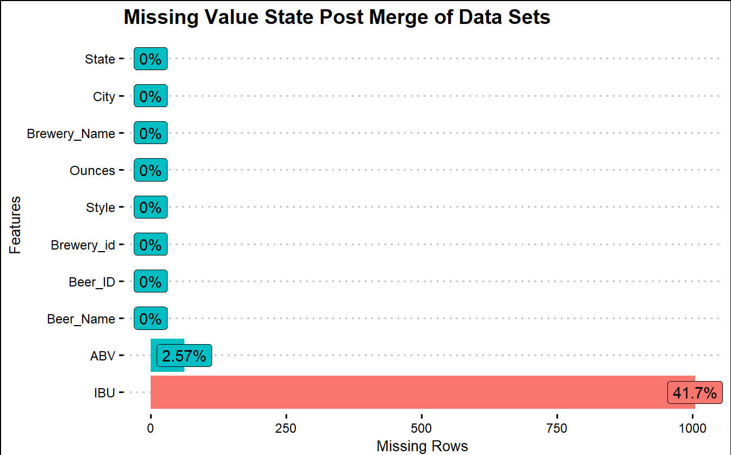
Missing Values
62 (2.57%) observations both ABV and IBU are empty
943 (41.7%) observations only IBU is empty
We made some realistic assumption that, a beer can exist without bitterness but probably not without alcohol.
We have excluded all the ABV observations with NA’s and replaced IBU NA’s with zeros
Factoid
Budweiser Prohibition Brew is only non-alcoholic beer, and which is not part of the dataset
Notes:
Stretch, highlight, and add text. Add factoid about non-alcoholic beers especially for bud
Speaker: Rajesh
Notes: There are 62 (2.57%) observations where both ABV and IBU are empty, 943 (41.7%) observations where only IBU is empty.
For all observations that had both only IBU empty, the NA value was changed to zero since having a non-bitter alcoholic beer is possible. Whereas we choose not to include any observations that had zero ABV. That just isn’t a real beer. This leaves us with only 2.57% of the observations not being used.
This is how we addressed missing values, there are 2.6% of observations where both ABV and IBU are empty and 41.7% of total observations just IBU, which are empty. We made some realistic assumption that, a beer can exist without bitterness but probably not without alcohol. So, we have excluded all the ABV observations with NA’s and replaced IBU NA’s with zeros

Slide 5
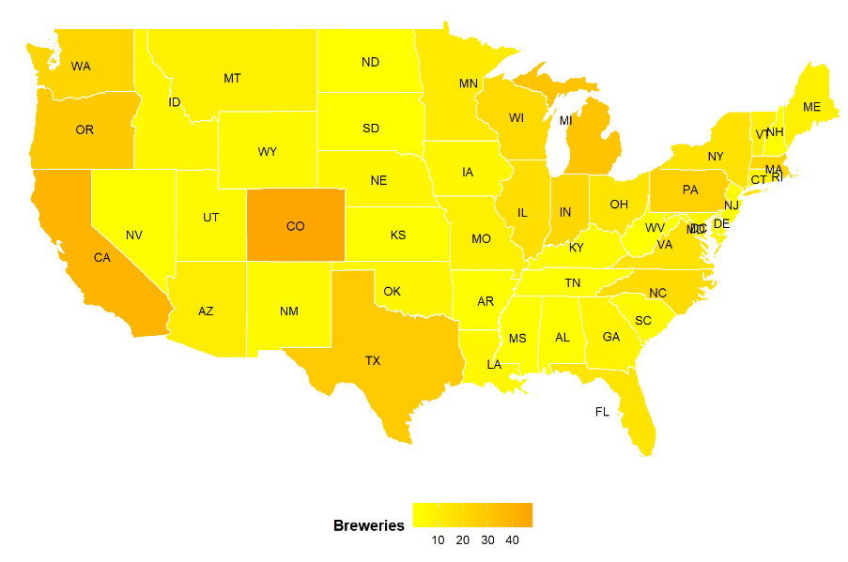
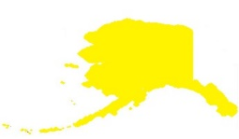
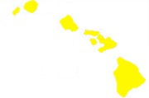
Breweries by State
Colorado
Clustered around two major cites Denver and
Boulder
Avery Brewing - famous.
Why CO has the largest number of breweries?
Water is extremely well suited for brewing great tasting beer
Regular water alon has 80-90% of water chemistry
What’s in the water ?
AK
Perfect mix of magnesium, sodium, sulfates, bicarbonates and calcium which determines the water's hardness.
HI
A gold medal winner of 2017 Great American Beer Festival
Notes:
Speaker: Kris
Notes:
The top 5 breweries make up 31.3% of the breweries in the US.
Colorado has 47 breweries which is 8 more than California which is second with 39 breweries.
Within Colorado most of the breweries seems to cluster around two major cites Denver and
# Boulder. Within Boulder a breweries company call Avery Brewing alone holds
# nearly three times the average number of Colorado breweries
# Many of these breweries offers free samples just for stepping inside.
# And this is what I found most interesting about why CO has the largest number of
# breweries.
#It is because Colorado’s water is extremely well suited for brewing great tasting beer,
# just the slight mineral adjustment and simple filtrations with very minimal treatment produces
# the best beer in the whole country. Which mean with just very little investment, you can produce
# best-in class beers with wide variety.
# Just the regular water along has 80-90% of water chemistry required to make Beer which is very fascinating.
# So what is there in CO water that makes it the best for brewing ?
# Co water has the perfect mix of magnesium, sodium, sulfates, bicarbonates and calcium which
# determines the water's hardness and ultimately its suitability for brewing and great test.
# Hence water chemistry is a major reason why Colorado has so many breweries excelling in different styles of beer from around the world
# Lone Tree won a gold medal at the 2017 Great American Beer Festival

Slide 6
Breweries by State
New Hampshire
Highest beer consumer
No sales Tax
Only has three Breweries
Utah
Lowest beer consumer
Four Breweries, mostly in Salt Lake City
Max allowed ABV < 4%
The highest number of breweries - west of the Mississippi river
Notes:
4 states (DC, N Dakota, S Dakota, and West Virginia) only had 1 brewery
and 4 more states (Arkansas, Delaware, Mississippi, and Nevada) only have two breweries.
Nevada was a shock due to it being the home of Las Vegas. The highest number of breweries appears to be west of the Mississippi river. However, the northeast united states has its fair share.
South and North Dakota had the lowest # of breweries, but the 3rd & 4th highest beer consumption per capita.
New Hampshire has the highest consumption, but only 3 breweries. NH has no sales tax on beer, hence the people from other states such as Vermont, Massachusetts, and Maine also come to NH for beer. There NH has has the bigger market opportunity for beer.
Utah has 4 breweries, but the lowest beer consumption could be because it’s a Mormon state. The biggest city in Utah, Salt Lak City, only allows < 4.0% ABV
With the popularity of craft beers and breweries. The pacific northwest is gaining on CA and CO for # of breweries. Beer consumption for Oregon is 14th and Washington 37th. Both have increased consumption by 9% in last 5 years.

Slide 7
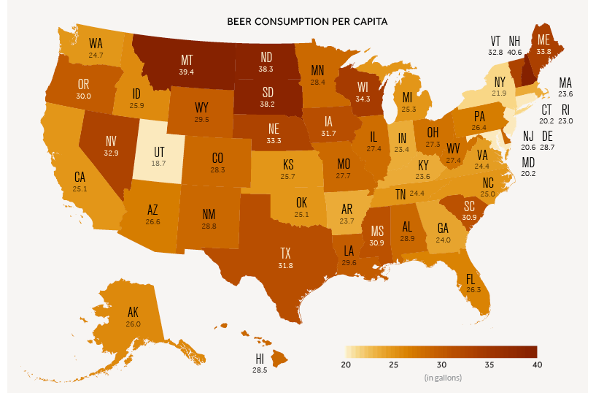
Breweries by State
North and South Dakota
The lowest # of breweries, but the 3rd & 4th highest beer consumption per capita.
Budweiser should consider North and South Dakota as homes for new breweries
Notes:
4 states (DC, N Dakota, S Dakota, and West Virginia) only had 1 brewery
and 4 more states (Arkansas, Delaware, Mississippi, and Nevada) only have two breweries.
Nevada was a shock due to it being the home of Las Vegas. The highest number of breweries appears to be west of the Mississippi river. However, the northeast united states has its fair share.
Beer Consumption Per Capita comes from https://www.visualcapitalist.com/united-states-of-beer/

Slide 8
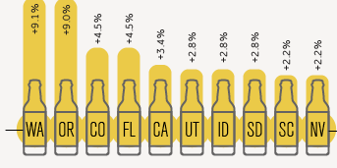
Breweries by State
AK
HI
With the popularity of craft beers and breweries. The pacific northwest is gaining on CA and CO for # of breweries. Beer consumption for Oregon is 14th and Washington 37th. Both have increased consumption by 9% in last 5 years.
Notes:
Speaker: Kris
Notes:
The top 5 breweries make up 31.3% of the breweries in the US.
Colorado has 47 breweries which is 8 more than California which is second with 39 breweries.
4 states (DC, N Dakota, S Dakota, and West Virginia) only had 1 brewery
and 4 more states (Arkansas, Delaware, Mississippi, and Nevada) only have two breweries.
Nevada was a shock due to it being the home of Las Vegas. The highest number of breweries appears to be west of the Mississippi river. However, the northeast united states has its fair share.
Beer Consumption Per Capita comes from https://www.visualcapitalist.com/united-states-of-beer/

Slide 9
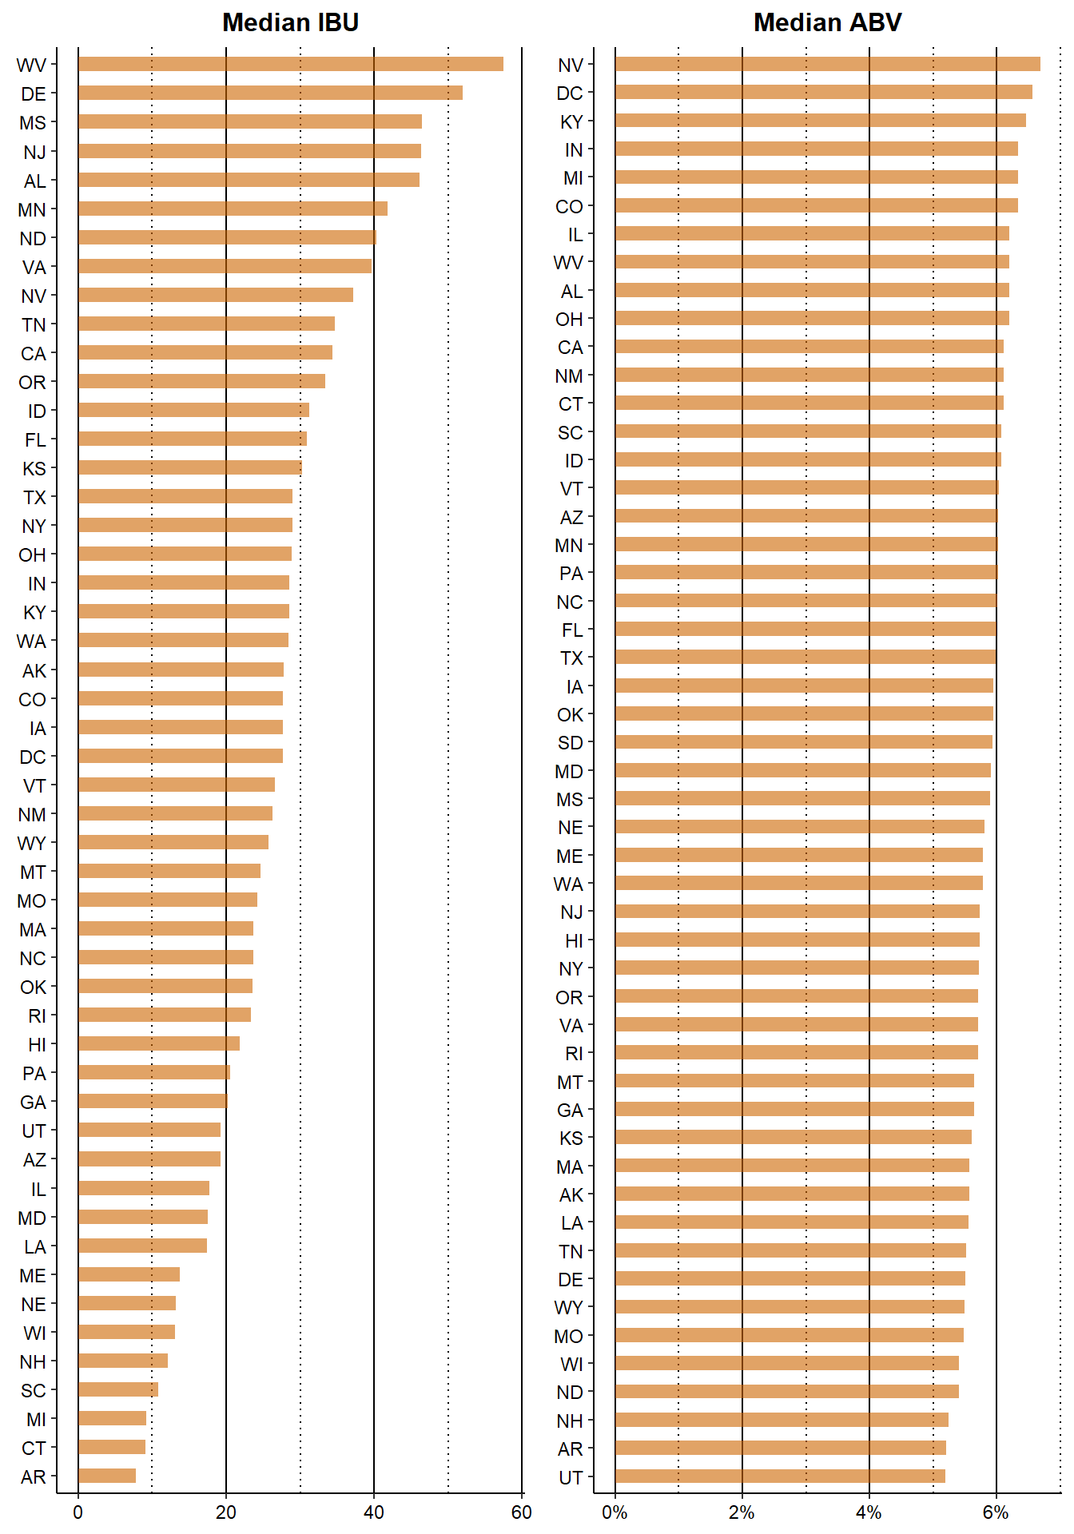
Median ABV and IBU
IBU range is 57.5 (WV) to 7.8 (AR)
IPA’s tend to have the biggest impact on IBU
ABV median range is 6.7% (NV) to 5.19% (UT)
Notes:
The average ABV is 6%. The middle 50% of the data fall between 5% and 6.7%. You may want to target this range during production.
Speaker: Kris
Notes: The median ABV per state appears somewhat consistent with an overall ABV median of 0.056, if you exclude the states with zero ABV.
Nevada has the highest median at 0.0669 ABV and Utah has the lowest at 0.051 ABV.
The median IBU per state appears to vary considerably between states with an overall IBU median of 37.
West Virginia has the highest median at 57.5 IBU and Arkansas has the lowest at 7.8 IBU if you exclude the states with zero IBU.

Slide 10
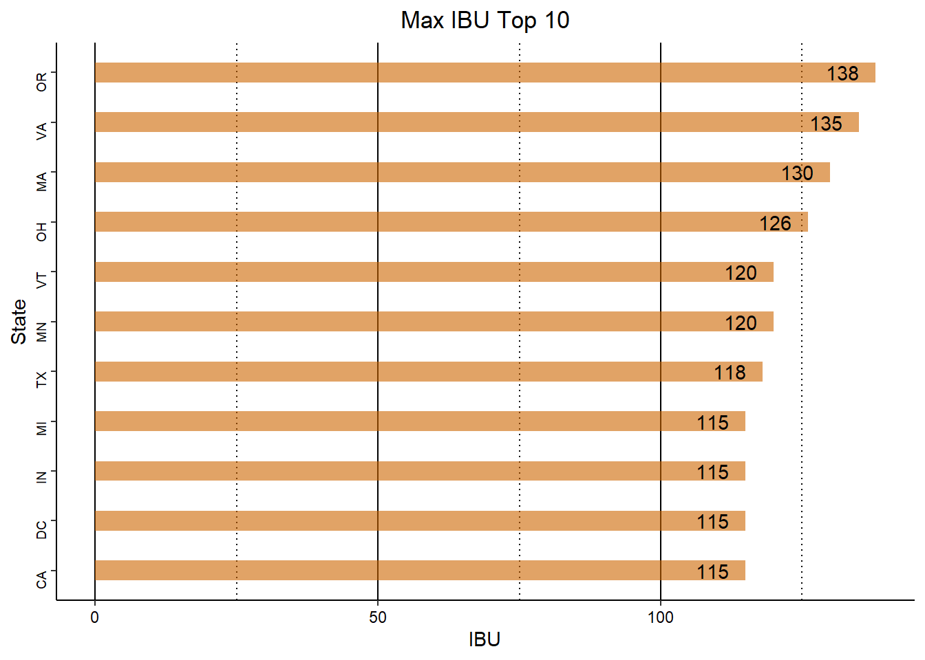
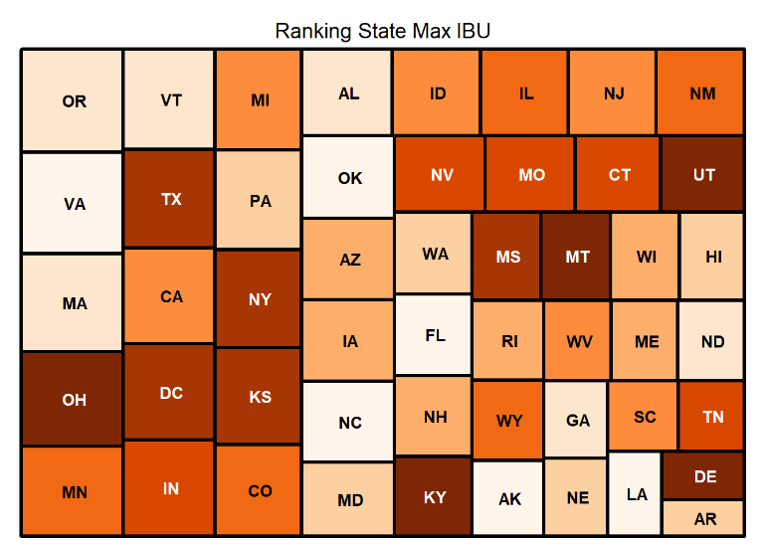
Max IBU
IBU max ranges from 138 (OR - Bitter Bitch Imperial IPA) to 0 (SD – 7 different beers)
AR (39) has the lowest non-zero IBU
Dogs Day Summer Ale (PA – 28) has the lowest non-zero IBU
90 IBU is the median max
26 states have a max IBU =>90
Notes:
Speaker: Thad Schwebke
Notes: The maximum IBU by state appears vary between states. Oregon has the highest Max IBU at 138 and Arkansas has the lowest at 44.11.

Slide 11
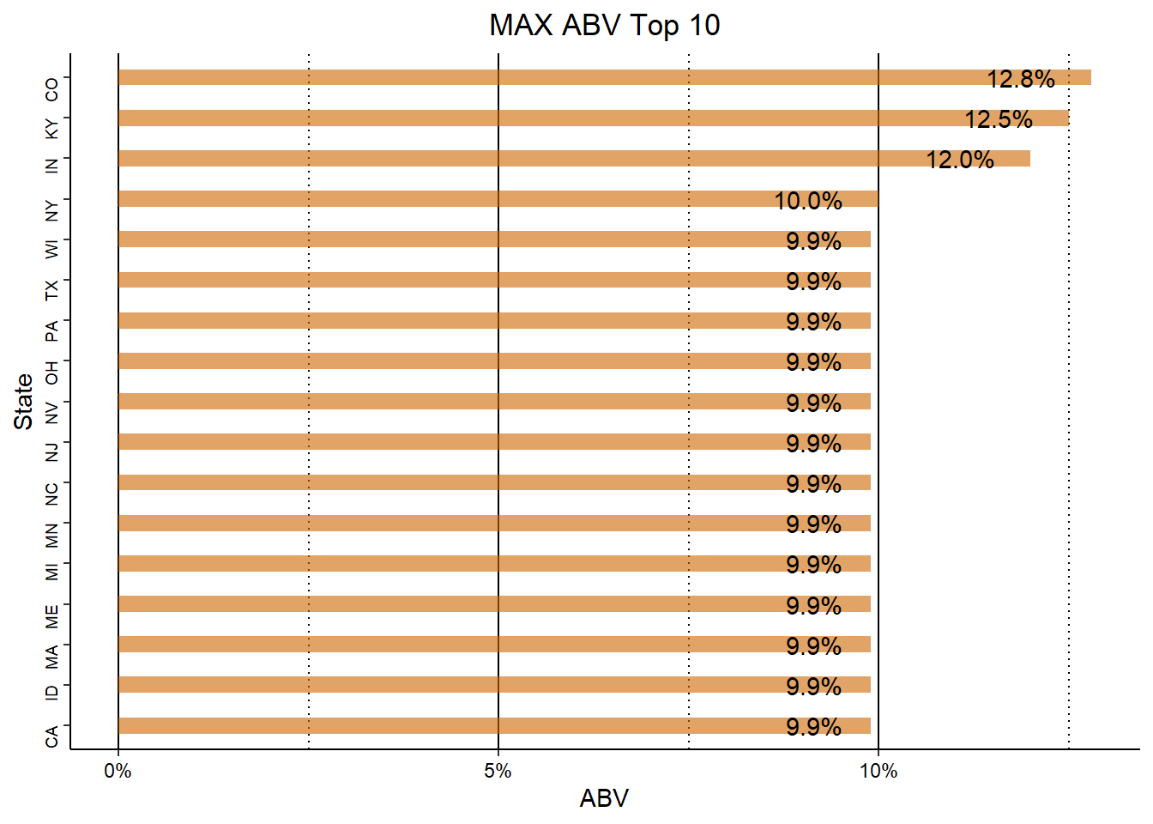
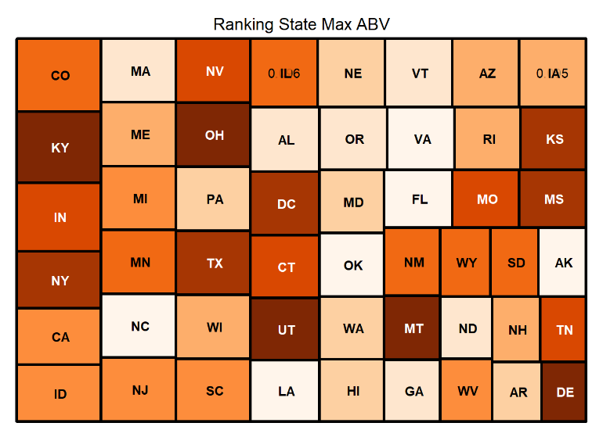
Max ABV
The national range is 12.8% (CO - Lee Hill Series Vol. 5 - Belgian Style Quadruple Ale) to 4.5% (SD – Easy Livin’ Summer Ale)
Max median by state is 5.87%
Delaware has the lowest max median (5.5%)
In Utah beer sold in a grocery store has to be <5.0% ABV, if >5.0% ABV then beer is sold in state-controlled stores
Notes:
Speaker: Thad Schwebke
Notes: The maximum ABV by state appears to have only a small variance between states. Colorado has the highest Max ABV at 0.128 and Delaware has the lowest at 0.055.

Slide 12
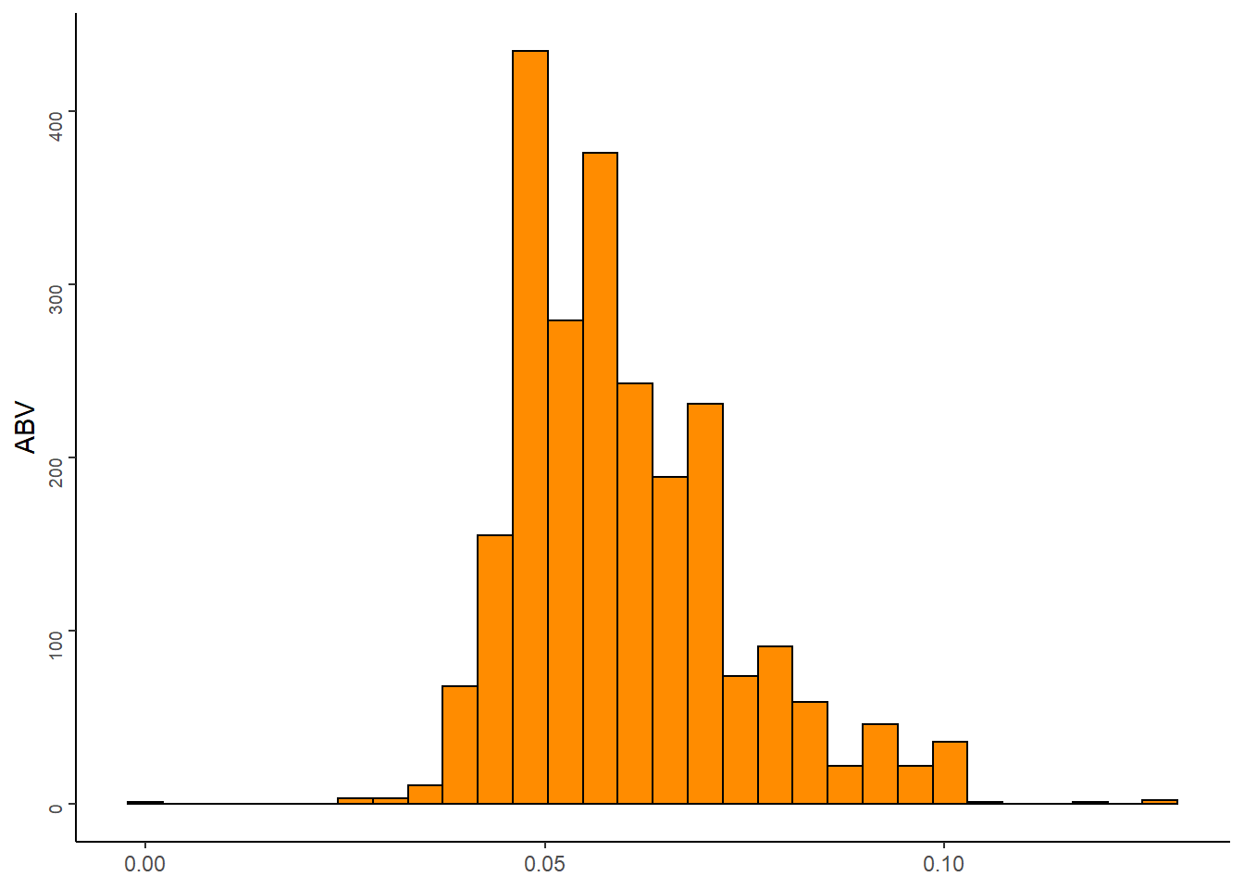
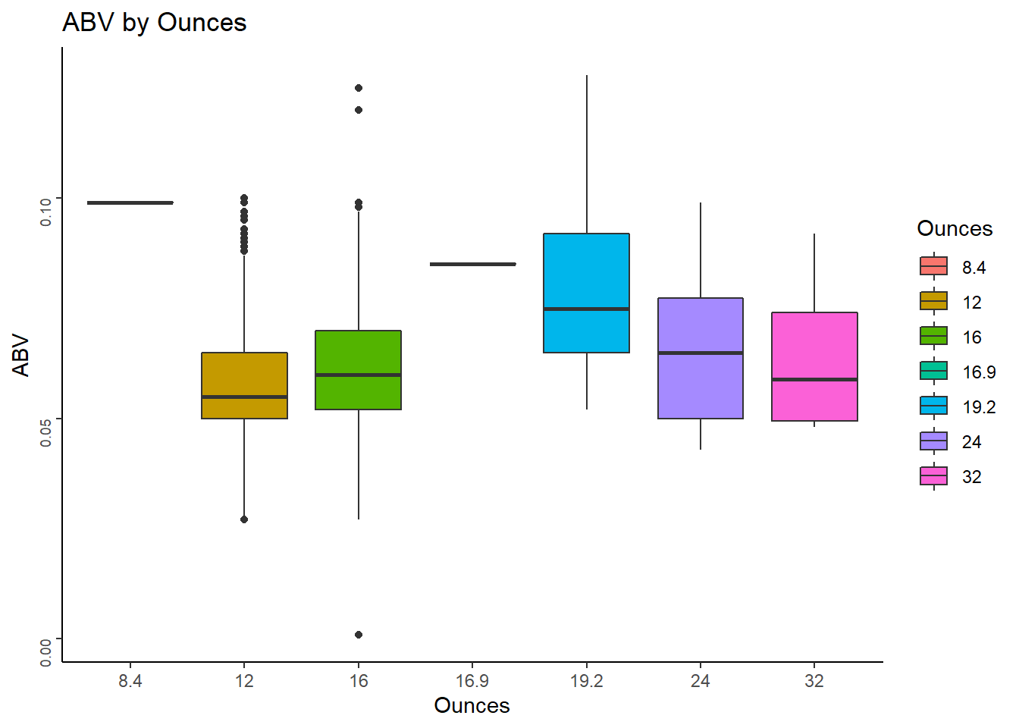
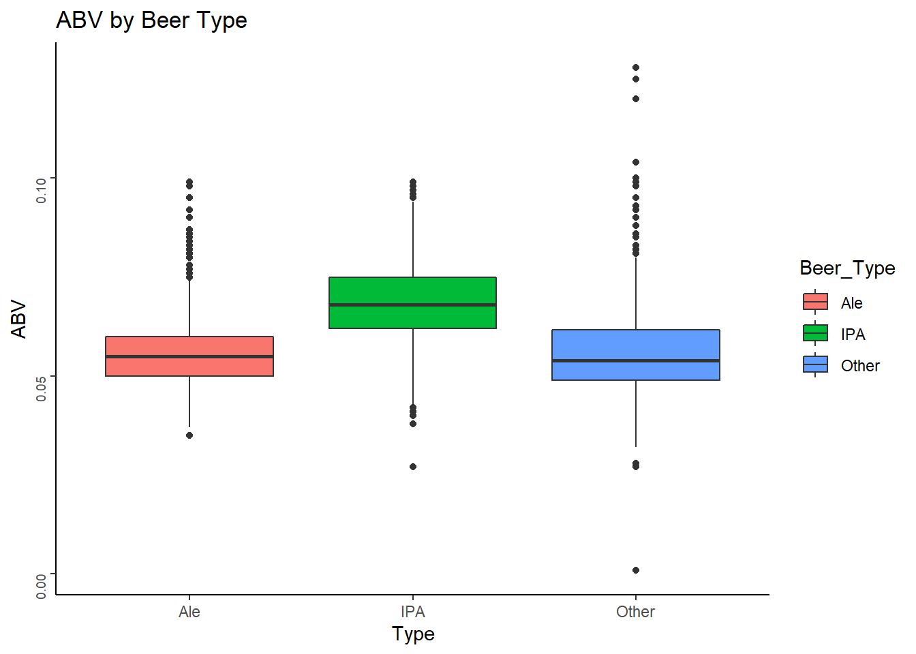
ABV Stats and Distribution
19.2 ounces is the new 12 ounce. Beers are packaged in 4 packs at 16.9 ounces or greater. 12-ounce beers generally are bought in 6-packs
In AL, beer containers may not exceed 25.4 ounces
IPA’s have more ABV than Ale’s and other beers
Notes:
Speaker: Thad Schwebke
Notes: The histogram shows that the ABV data is normally distributed but appears to have some small outliers on both ends. The two box plots illustrate that IPA has a higher overall median ABV at ~.8 ABV, however Other has several outliers that sit above the median (i.e. several greater than .12 ABV). 19.2 ounce beers tend to have the higher ABV, but the 16 ounces has a few outliers on the high side. One could also argue that 8.4 ounce beers has the highest median. The problem with this would be the number of observations that were 8.4 ounces. It appears to be a single observation.

Slide 13
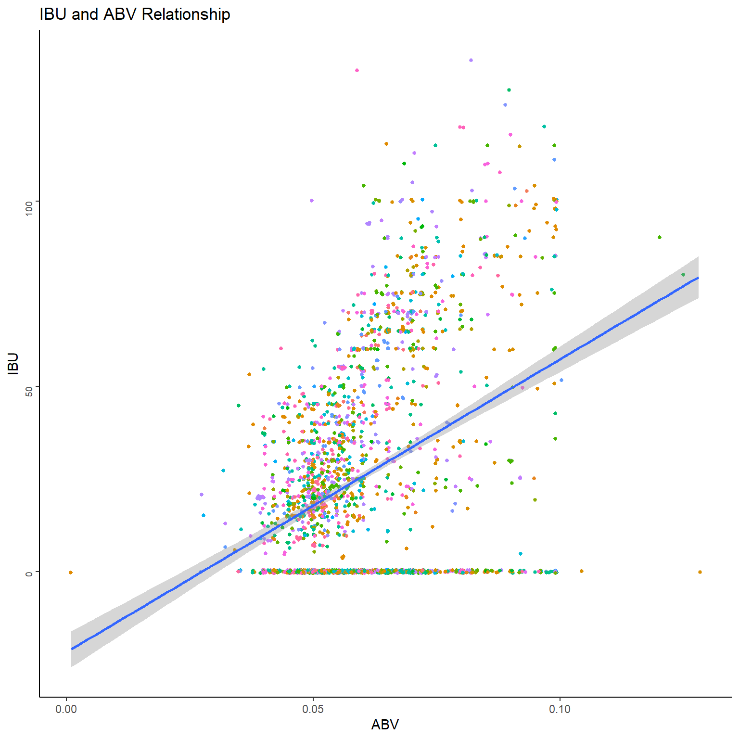
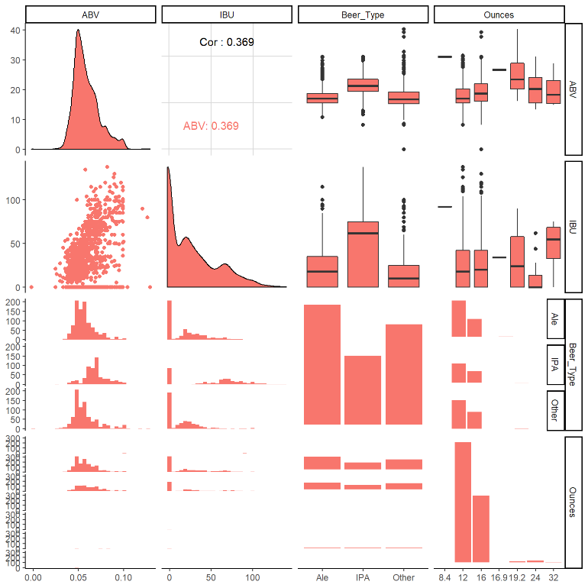
Relationship Between IBU and ABV
Bitterness generally rises with alcohol content, however they are not clearly dependent on one another
Notes:
Speaker: Thad Schwebke
Notes: The dot plot illustrates what appears to be a positive linear relationship between the ABB and IBU. The addition of the trend line somewhat confirms the presence of a positive linear relationship between the ABV and IBU. More analysis would be needed to confirm.

Slide 14
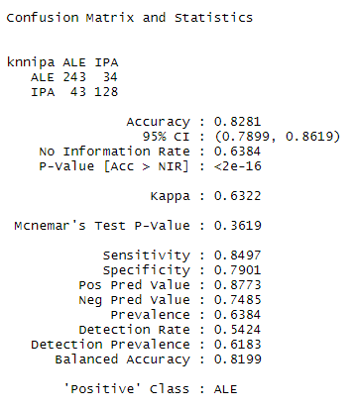
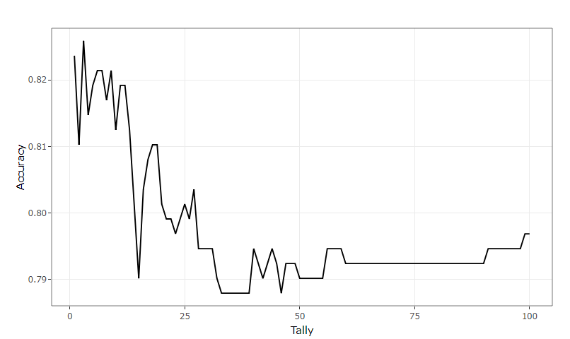
KNN Classification
Difference between IPAs (Indian Pale Ales) and Other Beers with respect to IBU and ABV
Confusion Matrix and Accuracy
KNN model predicts the outcome with an accuracy of 83%.
Optimized K value of 3
Notes:
Our KNN model predicts the outcome with an accuracy of 83% which is pretty good.
Optimized K value to 3 based upon 100 iterative run.

Slide 15
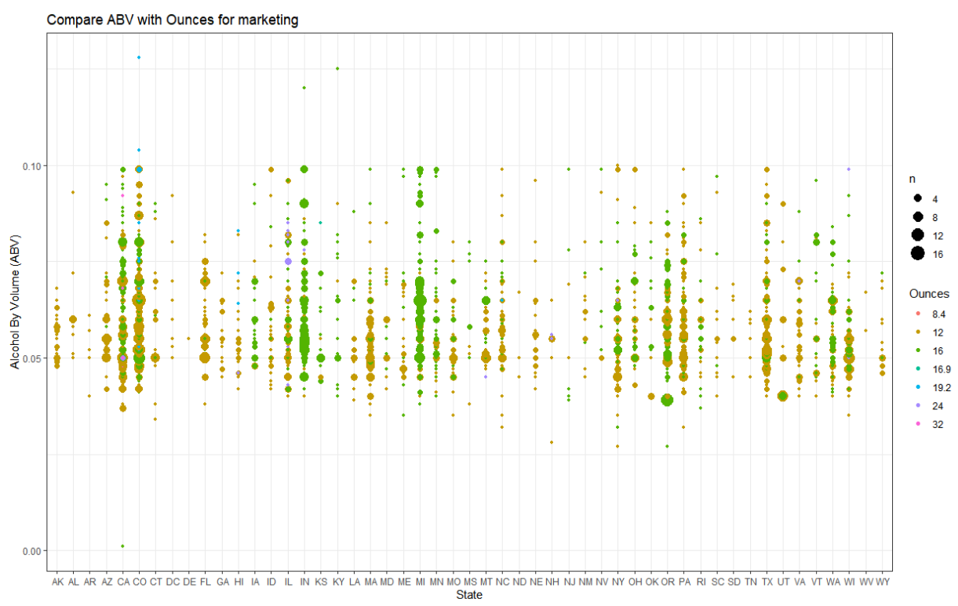
ABV And Ounces By State
Consumers based on their consumption habits and State
Breweries
Most consumed beer is 12 and 16 ounces
Notes:
Create a bubble chart showing which states tend to prefer larger bottles of beer with higher ABV for marketing purposes.
# This information is useful in that it can be used to target the beer consumers based on their consumption habits ( ABV and Size of the beer) and location.
# By visualizing the Ounces of beer bottles and cross referencing this data with ABV we are able to see a pattern (we can clearly see that most of the 12 and 16 ounces).
# The pattern can then be layed over states to show which states may act as the largest consumers of beer products.
# Lighter blue circles that sit higher on the graph show high alcohol content consumption.
We can see the trend that most consumed beer is 12 and 16 ounces

